Slide 1
Thesis Oral Defense
FLAIRE
Flood Level AI Risk Evaluation
An offline-first flood early-warning prototype · Barangay Elvita, Narra, Palawan
Solar LoRa node
Raspberry Pi 5
RF + fuzzy logic
≈ ₱27,920
Decision-support tool — the BDRRMC makes the call.
Notes:
Open with the problem: advisories are municipality-wide — they don't say whether this barangay is affected — and connectivity drops when warnings matter most.

Slide 2
02 · Background of the study
Background of the study
Notes:
Placeholder slide per user request — insert background-of-study material here before the defense.

Slide 3
03 · STATEMENT OF THE PROBLEM
Statement of the problem
1
What are the key problems and limitations in current flood-warning practices and data utilization in Brgy. Elvita, Narra, Palawan, and how can these be addressed through an offline-first, AI-based flood early-warning system?
2
How can a Fuzzy-AI riverine flood-risk classification system be designed and developed for Brgy. Elvita that integrates:
cached seven-day weather and tide forecast data from OpenMeteo (updated at least daily, every six hours, and stored in a local database);
real-time water-level and rainfall data from a LoRa-based hydrological sensor node transmitted to a Raspberry Pi 5 edge device;
a hybrid AI pipeline in which a Random Forest model estimates flood propensity using R1, R3, R7, rain_days, TMAX, TMIN, TideMax, and TideMin while a fuzzy-logic classifier with 20 rules classifies flood risk as Receding, Alert, Alarm, or Critical;
and a local web dashboard accessible through a LAN, enabling BDRRMC personnel to monitor real-time sensor data, AI-based risk classifications, and visualizations without internet connectivity, with alerts delivered through the dashboard and SMS?
Notes:
Statement of the problem from thesis Chapter 1: current flood-warning limitations in Brgy. Elvita and the five research questions FLAIRE seeks to answer.

Slide 4
03 · STATEMENT OF THE PROBLEM
Statement of the problem
3
How consistently does the Random Forest flood-propensity model reproduce the rule-derived Low, Medium, and High flood-propensity categories on a held-out test set, in terms of accuracy, precision, recall, and F1-score?
4
How did the FLAIRE prototype perform during a limited field deployment in terms of sensor-data capture, data logging, and data quality?
How acceptable is the developed FLAIRE system to the BDRRMC focal persons of Brgy. Elvita, Narra, Palawan in terms of functionality, usability, reliability, perceived contribution to disaster preparedness, attitude toward use, and intention to use, as measured through a Technology Acceptance Model (TAM)-based interview or survey?
5
Notes:
Statement of the problem from thesis Chapter 1: current flood-warning limitations in Brgy. Elvita and the five research questions FLAIRE seeks to answer.

Slide 5
04 · Significance of the study
Significance of the study
Who benefits
BDRRMC (Barangay Elvita)
Offline-first, AI-enhanced flood early-warning: flood-risk classifications from real-time sensor data and cached forecasts through a LAN dashboard — supporting informed decisions, preemptive evacuation planning, and resource allocation even during internet or power interruptions.
Barangay officials & residents
Timely flood notifications through SMS alerts and dashboard-based monitoring, improving community preparedness and resilience in a flood-prone, low-connectivity setting.
Academic community
A documented, reproducible offline-first hybrid Random Forest + fuzzy-logic flood-risk classification for a rural Philippine barangay, with an honest account of its labeling and validation limits.
Policy-makers & future deployments
Evidence that barangay-scale early warning can run with minimal internet dependency and edge-based AI — an initial basis for scaling low-cost, power-resilient monitoring to similar communities.
Notes:
Beneficiaries per thesis Chapter 1: BDRRMC, barangay officials and residents, the academic community, and policy-makers / future deployments.

Slide 6
05 · Scope and Delimitation
Scope and Delimitation
In scope vs. boundaries
In scope
Delimitations
● Design, development, and pilot deployment of FLAIRE — offline-first hybrid Fuzzy-AI riverine flood-risk classification and early-warning system, Brgy. Elvita, Narra, Palawan (one vulnerable river section)
● Historical data (PAGASA, NAMRIA) + cached Open-Meteo forecasts (6 h refresh), stored locally in SQLite
● LoRa sensor node → Raspberry Pi 5 edge device; RF flood propensity (8 features) + 20-rule fuzzy logic → four risk levels
● LAN dashboard + SMS alerts; BDRRMC retains alert authority
● Held-out test-set evaluation (80/20) and TAM acceptability survey (n = 2 focal persons)
● Riverine flooding only in Brgy. Elvita — excludes coastal flooding, upstream flash floods, areas outside the barangay
● Single sensor node; no full river-system coverage
● Decision support, not prediction: rule-derived labels; no measured forecast lead time; no threshold-baseline comparison
● Preliminary four-event check only; limited deployment duration (~21.5 h)
● n = 2 survey — preliminary, not generalizable
● Dependent on historical / forecast / real-time data availability and quality
Notes:
Faithful to thesis Chapter 1: barangay-scale offline-first prototype, decision-support framing, n=2 acceptability survey, ~21.5 h deployment.

Slide 7
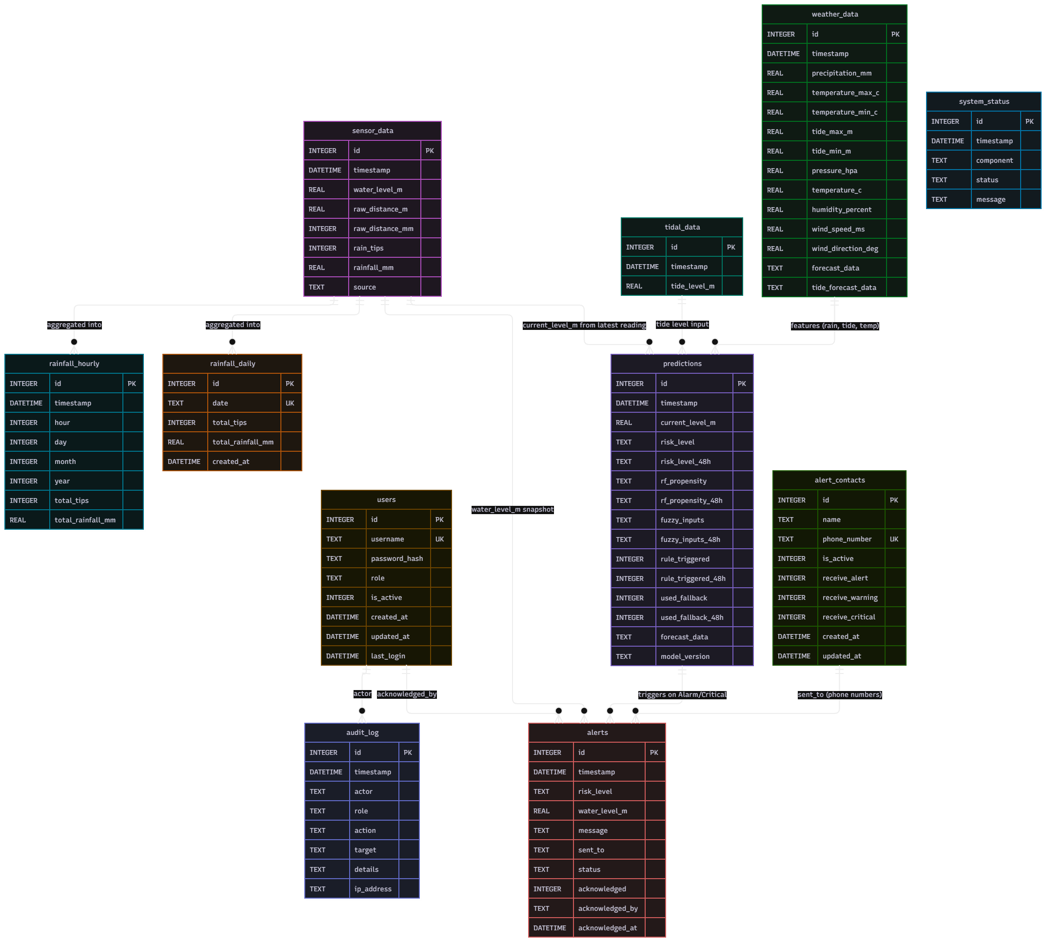
06 · Entity relationship diagram
Entity relationship diagram
River-monitor database schema — insert figure
Notes:
ERD placeholder — insert the database diagram from DATABASE_ERD.md here.

Slide 8
06 · Entity relationship diagram
Entity relationship diagram
River-monitor database schema — insert figure
Notes:
ERD placeholder — insert the database diagram from DATABASE_ERD.md here.

Slide 9
06 · Entity relationship diagram
Entity relationship diagram
River-monitor database schema — insert figure
Notes:
ERD placeholder — insert the database diagram from DATABASE_ERD.md here.

Slide 10
06 · Entity relationship diagram
Entity relationship diagram
River-monitor database schema — insert figure
Notes:
ERD placeholder — insert the database diagram from DATABASE_ERD.md here.

Slide 11
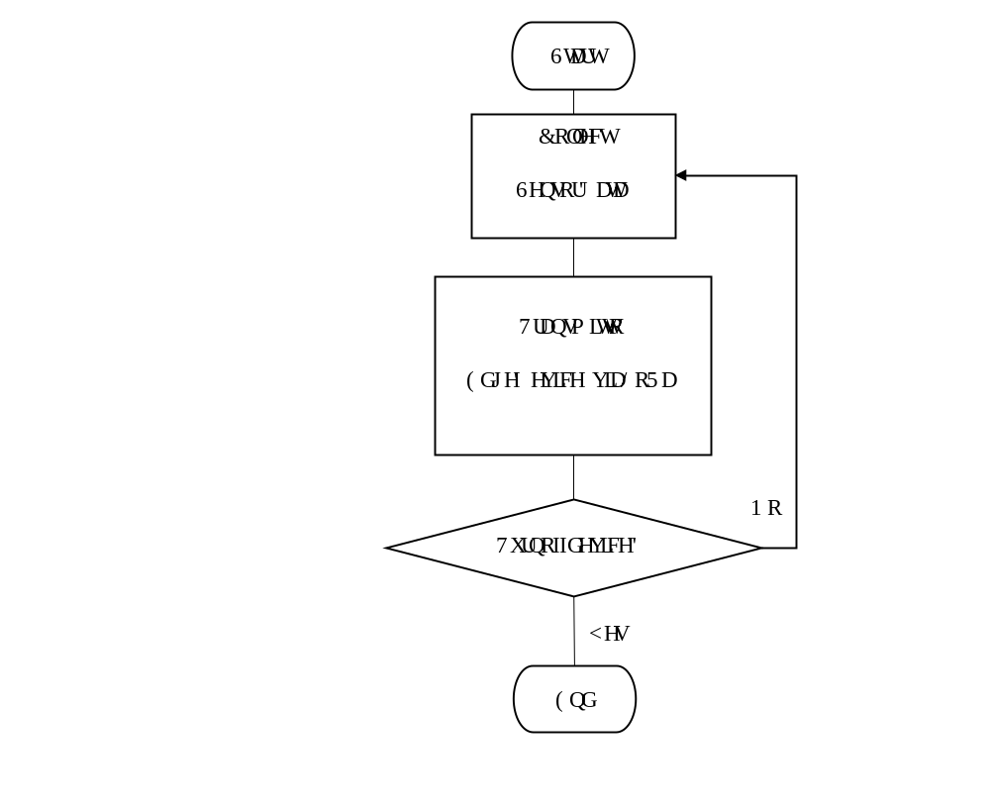
07 · SYSTEM FLOWCHART — NODE
System flowchart — sensor node
Field sensing segment
Notes:
Field sensor node segment: ultrasonic water-level + tipping-bucket rain gauge, on-board controller, LoRa RFM95W @ 915 MHz, 1-min cadence, solar/battery power.

Slide 12
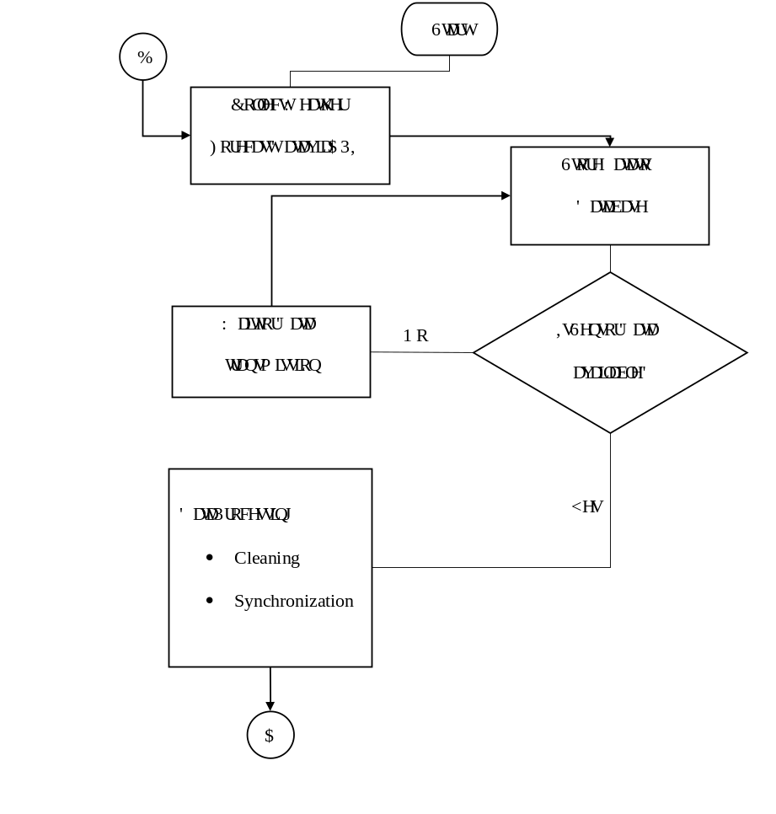
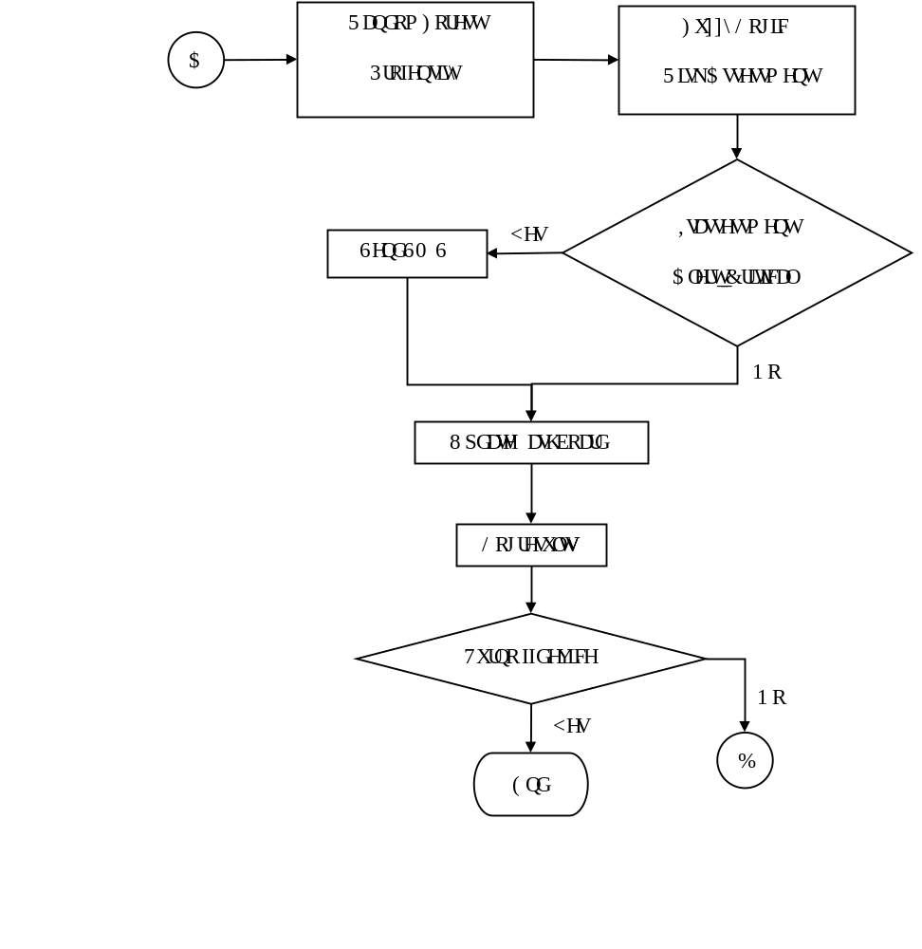
08 · SYSTEM FLOWCHART — EDGE DEVICE
System flowchart — edge device
Raspberry Pi 5 segment
Notes:
Field sensor node segment: ultrasonic water-level + tipping-bucket rain gauge, on-board controller, LoRa RFM95W @ 915 MHz, 1-min cadence, solar/battery power.

Slide 13
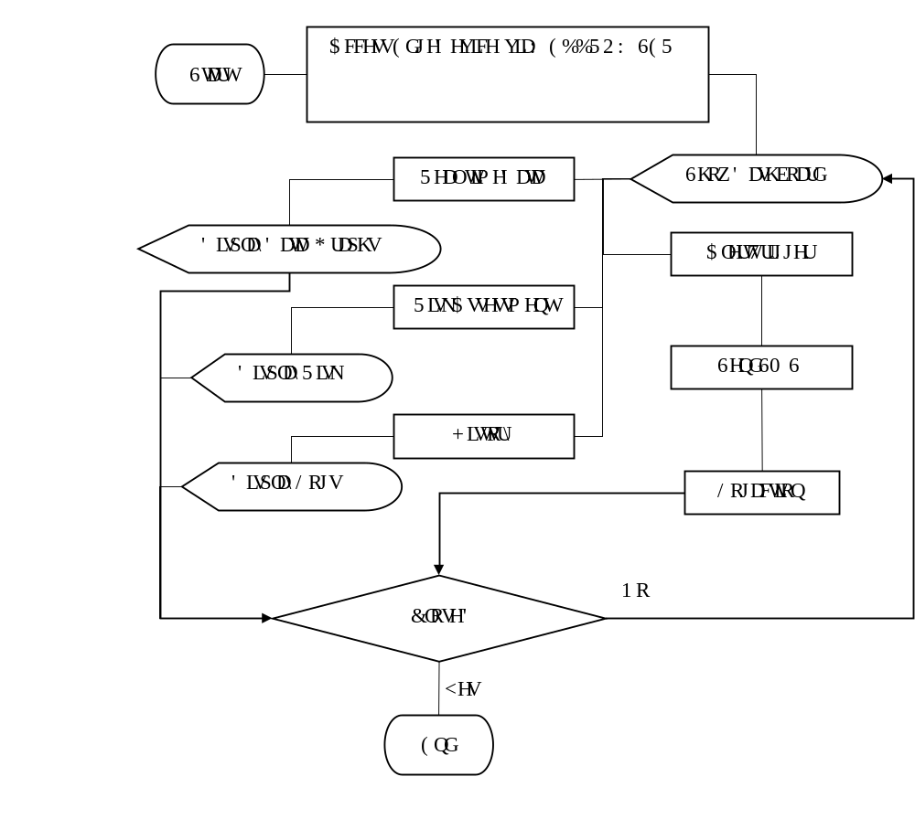
09 · SYSTEM FLOWCHART — DASHBOARD
System flowchart — dashboard
FastAPI web dashboard segment
Notes:
Field sensor node segment: ultrasonic water-level + tipping-bucket rain gauge, on-board controller, LoRa RFM95W @ 915 MHz, 1-min cadence, solar/battery power.

Slide 14
10 · COST AND BENEFITS
Cost and benefits
Bill of materials & expected benefits
Node
₱7,070
Edge
₱19,050
General
₱1,800
Adafruit RFM95 LoRa
Mini magnets
Meshtastic 915 MHz LoRa antenna
Reed switch
MCP73871 power boost
UART 7.5 m waterproof ultrasonic sensor
3.5 W solar panel
3.7 V 10 Ah battery
Enclosure box
PVC pipe
Housing materials
₱2,500
₱100
₱300
₱200
₱300
₱1,500
₱200
₱220
₱250
₱1,000
₱500
Meshtastic 915 MHz LoRa antenna
52Pi RPi5 power expansion board
Micro SD card
RPi5 active cooler
Raspberry Pi 5 2 GB board
12 V 12 Ah LiFePO4 battery pack
LoRa RFM95W transceiver board
60 W solar panel w/ controller
SIMCOM A7608e-H
SMS load (yearly)
₱300
₱1,600
₱750
₱250
₱6,500
₱2,220
₱2,000
₱1,900
₱1,530
₱2,000
Breadboard (2 × 100)
Wires
Marine plywood
Miscellaneous electrical components
₱200
₱200
₱400
₱1,000
Subtotal — ₱1,800
Subtotal — ₱7,070
Subtotal — ₱19,050
Benefits (thesis):
Technical — continuous water-level and rainfall monitoring without constant internet; local storage; RF + fuzzy-logic pipeline on the Pi 5; LAN dashboard.
Operational — continuous hydrological information and AI risk classifications for BDRRMC personnel; Receding classification under stable conditions; Alert / Alarm / Critical with SMS during heavy rainfall.
Community — improved situational awareness and earlier preparedness; reduced dependence on visual observation and municipality-wide MDRRMO alerts. Final alert authority stays with the BDRRMC — decision-support, not autonomous warning.
₱27,920
Total build cost
Notes:
₱27,920 BOM — Node ₱7,070 · Edge ₱19,050 · General ₱1,800 — plus thesis benefit categories: technical, operational, community-level.

Slide 15
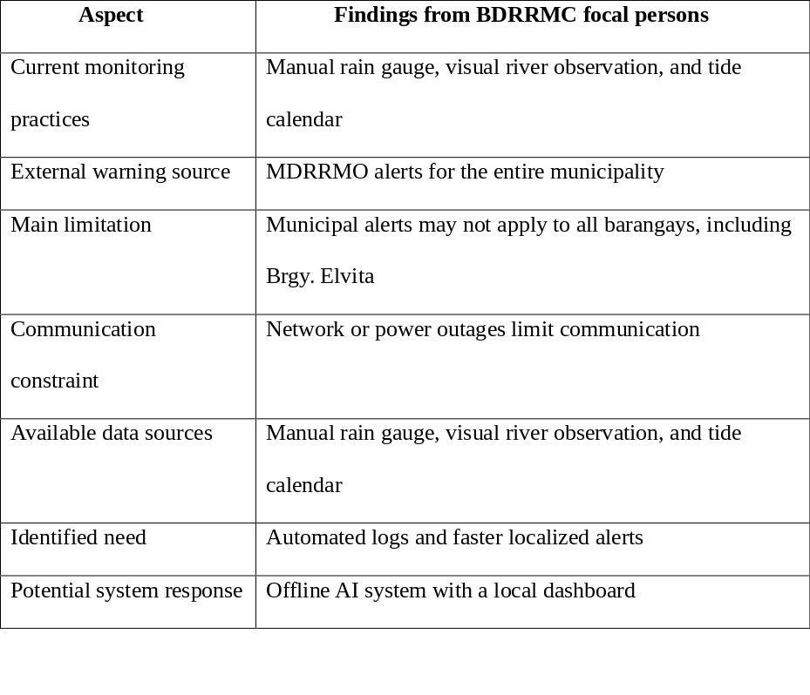
11 · RESULTS AND DISCUSSION — Q1
Results and discussion — Q1: Current practices & the warning gap
Q1: What are the key problems and limitations in current flood-warning practices and data utilization in Brgy. Elvita, and how can an offline-first, AI-based flood early-warning system address them?
Current monitoring relies on a manual rain gauge, visual river observation, and a tide calendar
MDRRMO advisories cover the whole municipality — an alert may not mean Brgy. Elvita is affected
Officials face uncertainty deciding whether an advisory needs local preparedness or response
Network or power interruptions can limit communication and warning/response efforts
No continuous, automated, barangay-specific water-level and rainfall records exist
Notes:
Q1 findings (thesis Ch.4): manual rain gauge, visual observation, tide calendar; municipality-wide MDRRMO alerts; no continuous localized records.

Slide 16
12 · RESULTS AND DISCUSSION — Q2
Results and discussion — Q2: System design & development
Q2: How can a Fuzzy-AI riverine flood-risk classification system be designed and developed for Brgy. Elvita integrating cached forecasts, a LoRa sensor node, an RF+fuzzy pipeline, and a LAN dashboard?
✓ Offline-first: cached Open-Meteo weather/tide forecasts stored locally on the Pi 5
✓ LoRa sensor node sends water-level + rainfall to the Raspberry Pi 5 edge device
✓ Hybrid AI pipeline: RF flood propensity (8 features) → 20-rule fuzzy → 4 risk levels
✓ Local SQLite database stores readings, forecasts, model outputs, and alerts
✓ LAN dashboard shows live status, graphs, RF/fuzzy results, alert history — no internet needed
✓ SMS via GSM modem (Alarm/Critical only); BDRRMC retains alert authority
Notes:
Q1 findings (thesis Ch.4): manual rain gauge, visual observation, tide calendar; municipality-wide MDRRMO alerts; no continuous localized records.

Slide 17
13 · RESULTS AND DISCUSSION — Q3
Results and discussion — Q3: Random Forest consistency
Q3: How consistently does the Random Forest reproduce the rule-derived Low, Medium, and High flood-propensity categories on a held-out test set?
94.26%
Accuracy
0.933
Macro F1
0.943
Weighted F1
1,826
Training records
2 of 4
Events matched rule
Trained 2020–2024 on PAGASA meteorological + NAMRIA tidal data (1,826 daily records)
Random stratified 80/20 split (1,460 train / 366 test); no cross-validation
Rule-derived labels (composite score ≥6.0 High, ≥3.0 Medium, <3.0 Low) from the same 8 features
Low F1 0.9728 · Medium F1 0.9099 · High F1 0.9160 · High recall 0.9524
External probe: 2 of 4 documented flood events (2020–2025) classified High by the rule — diagnostic case check, not validation
Notes:
Q1 findings (thesis Ch.4): manual rain gauge, visual observation, tide calendar; municipality-wide MDRRMO alerts; no continuous localized records.

Slide 18
14 · RESULTS AND DISCUSSION — Q4
Results and discussion — Q4: Field deployment performance
Q4: How did the FLAIRE prototype perform during a limited field deployment in terms of sensor-data capture, data logging, and data quality?
21.5 h
Logged
13,568
Records
Logged 13,568 LoRa records over ~21.5 h (intended ~47 h; battery depletion ended it early)
Water level stayed in the Low band (≈0.01–0.18 m), below the alert threshold
67 zero-distance, 124 negative, and 5 implausible-distance readings flagged for review
River stayed Receding — Alert, Alarm, and Critical classes could not be exercised
Notes:
Q1 findings (thesis Ch.4): manual rain gauge, visual observation, tide calendar; municipality-wide MDRRMO alerts; no continuous localized records.

Slide 19
16 · SUMMARY, CONCLUSION & RECOMMENDATION
Results and discussion — Q5: Acceptability (TAM)
Q5: How acceptable is FLAIRE to the BDRRMC focal persons in terms of functionality, usability, reliability, preparedness, attitude, and intention to use?
n = 2
Focal persons
5.00
Five dimensions
4.75
Usability
Two BDRRMC focal persons rated six TAM dimensions on a 5-point Likert scale
Five dimensions (functionality, reliability, preparedness, attitude, intention): 5.00
Usability: 4.75 — favorable initial feedback
Small-n caveat: encouraging but not generalizable to all barangay officials/residents
Perceived reliability read alongside deployment findings (battery depletion, anomalous readings)
Notes:
Q1 findings (thesis Ch.4): manual rain gauge, visual observation, tide calendar; municipality-wide MDRRMO alerts; no continuous localized records.

Slide 20
15 · RESULTS AND DISCUSSION — Q5
Summary, conclusion & recommendation
Chapter 5 — what the study establishes
Summary — key findings
Conclusion
Recommendation
MDRRMO alerts are municipality-wide; monitoring gaps remain — current practice is manual (rain gauge, visual observation, tide calendar).
RF reproduced its rule-derived labels (94.26% accuracy) — consistency, not independent flood-prediction skill.
Pilot logged 13,568 records over ~21.5 h at Receding; battery depletion ended deployment; acceptability 5.00 / 4.75 (n = 2).
Feasibility established — the offline-first hybrid RF + fuzzy-logic prototype runs end-to-end on a Pi 5.
Decision-support, not prediction — the BDRRMC makes the alert call.
Human-in-the-loop alerting (SMS at Alarm / Critical, BDRRMC confirmation) is essential.
Use independent, BDRRMC-validated flood labels.
Validate chronologically (e.g., train 2020–2023, test 2024).
Harden power: panel placement, battery capacity, voltage monitoring.
Expand the acceptability sample beyond n = 2.
Notes:
Q1 findings (thesis Ch.4): manual rain gauge, visual observation, tide calendar; municipality-wide MDRRMO alerts; no continuous localized records.

Slide 21
Thank you!
Mercy po
Notes:
Three key findings, feasibility conclusion (decision-support, not prediction), four recommendations — then 'Thank you — questions?'.

Slide 22
Defended ba?
Legit?
Notes:
Three key findings, feasibility conclusion (decision-support, not prediction), four recommendations — then 'Thank you — questions?'.

Slide 23

See you after 3 weeks
Notes:
Three key findings, feasibility conclusion (decision-support, not prediction), four recommendations — then 'Thank you — questions?'.

Slide 24
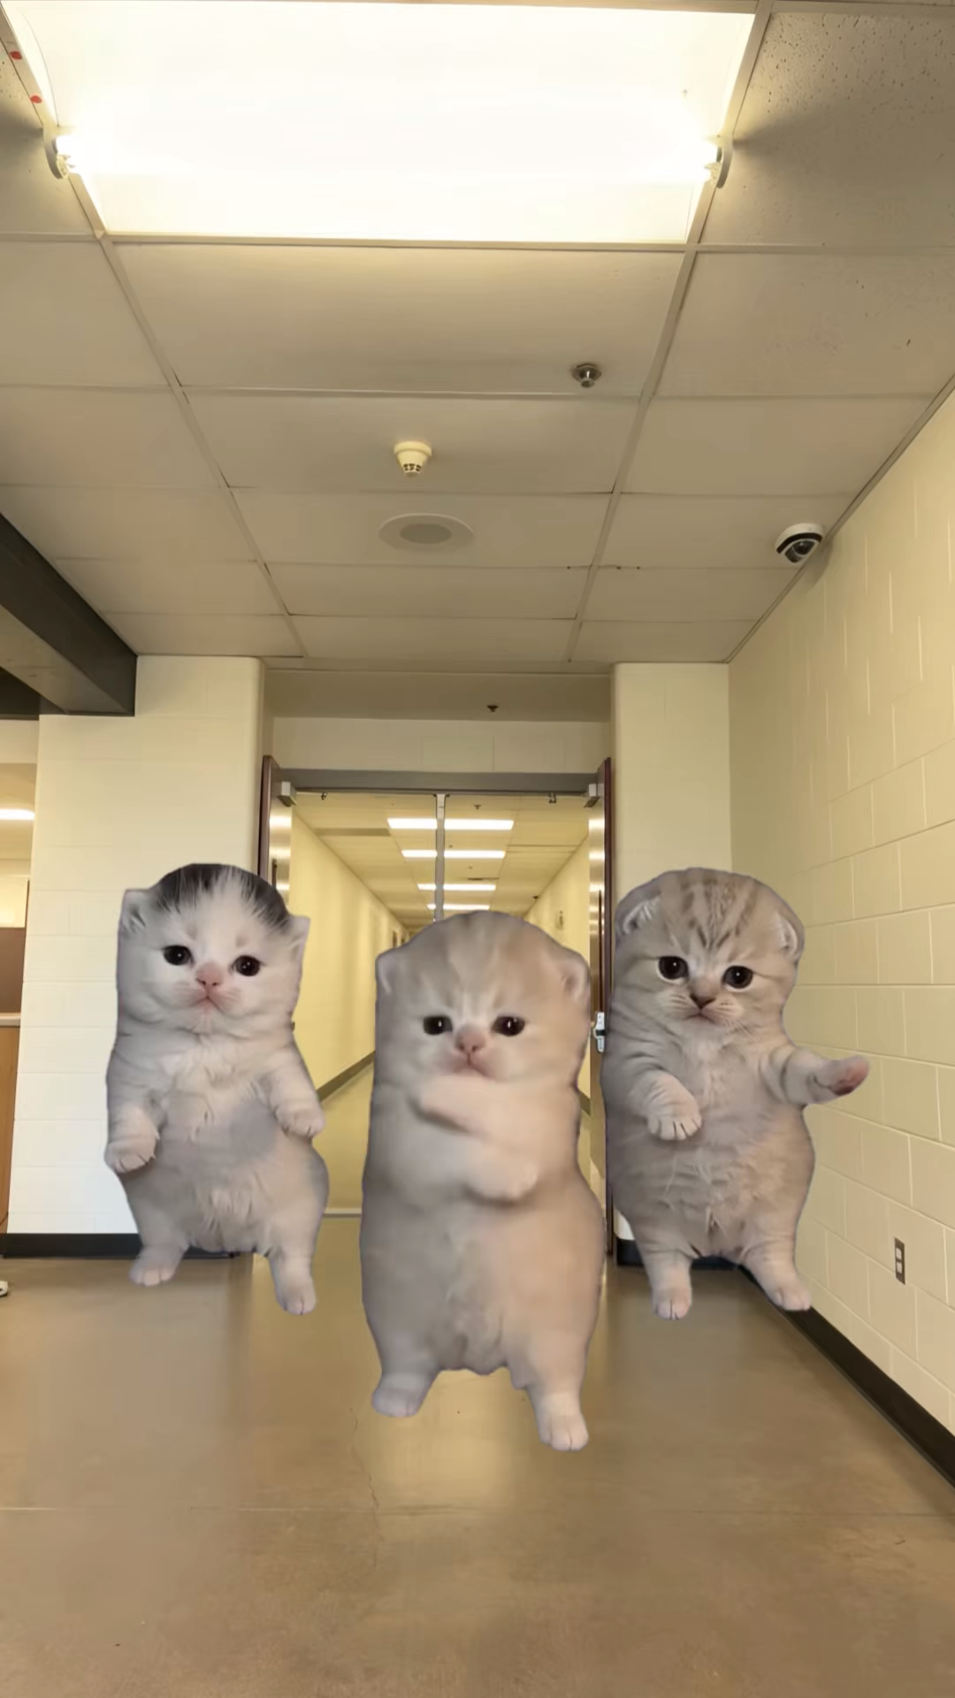


THESIS DEFENDED
Notes:
Three key findings, feasibility conclusion (decision-support, not prediction), four recommendations — then 'Thank you — questions?'.

